Slide 1
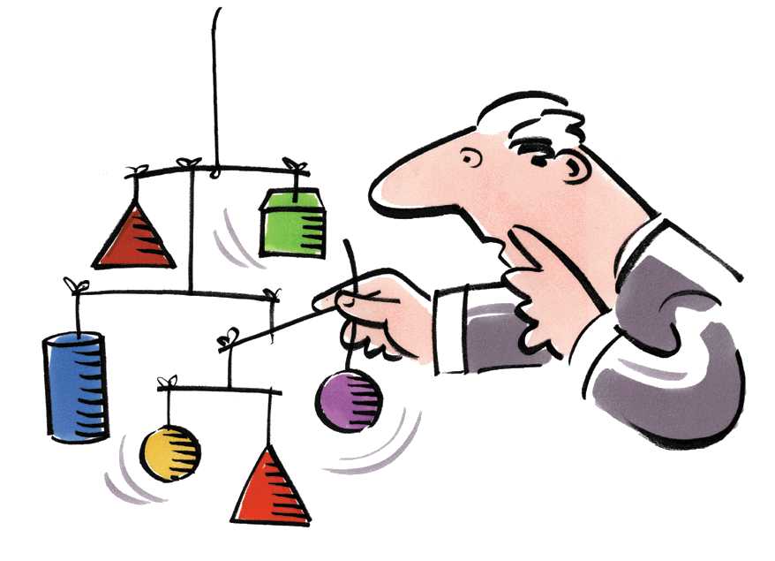
ArchiMate
Authors : eSchoolink Group - ITNLU

Slide 2
Contents
What’s ArchiMate ?
Why ArchiMate ?
Main Benefits of ArchiMate
Layers of ArchiMate
ArchiMate vs UML
Notations of ArchiMate
Demo

Slide 3
What is ArchiMate?
ArchiMate is a modelling technique ("language") for describing enterprise architectures.
It presents a clear set of concepts within and relationships between architecture domains, and offers a simple and uniform structure for describing the contents of these domains.
ArchiMate distinguishes itself from other languages such as Unified Modeling Language (UML) and Business Process Modeling Notation (BPMN) by its well defined metamodel, and wider enterprise modelling scope.

Slide 4
What is ArchiMate?
ArchiMate offers a common language for describing the construction and operation of business processes, organizational structures, information flows, IT systems, and technical infrastructure.
This insight helps the different stakeholders to design, assess, and communicate the consequences of decisions and changes within and between these business domains.

Slide 5
What is ArchiMate?
An architecture framework is used to structure the concepts and relationships of the ArchiMate language
It divides the enterprise architecture in to a business, application and technology layer. In each layer, three aspects are considered: active elements that exhibit behavior (e.g. Process and Function), an internal structure and elements that define use or communicate information.

Slide 6
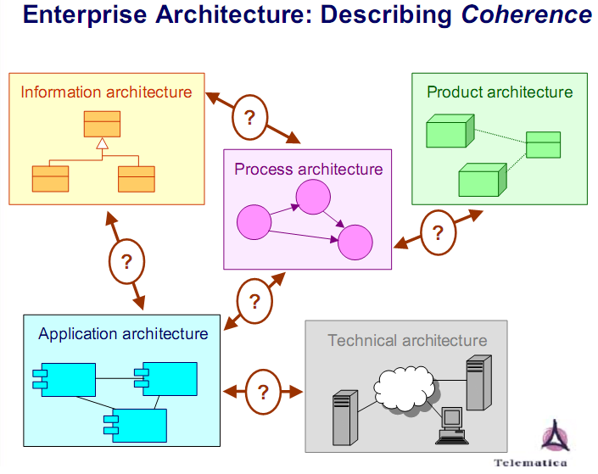

Slide 7
Why ArchiMate?
Enterprise architecture is an important instrument to address this company-wide integration.
It is a coherent whole of principles, methods and models that are used in the design and realization of the enterprise's organizational structure, business processes, information systems, and IT infrastructure.

Slide 8
Why ArchiMate?
A good architecture practice enables an organization to align business and IT operations with its strategy, quickly respond to changes in the environment, and make optimal use of technological opportunities.
The development and maintenance of architectures will lead to efficiency, cost reduction and flexibility.

Slide 9
Why ArchiMate?
Within companies various domain architectures can be found, like organization, business process, application, information, and technical architectures.
Each architecture domain has its own concepts for the modelling and visualization of its internal coherence. These specific models and visualizations simplify communication, discussion and analysis within the domain

Slide 10
Why ArchiMate?
However, the relations between the concepts in these different domains are in many cases unclear. Moreover, these domains often partially overlap but use different notions to express the same ideas, sometimes even with-out the people involved knowing this.
The resulting ambiguities and confusion stand in the way of the flexibly and efficiently operating organizations we envisage.

Slide 11
Why ArchiMate?
ArchiMate wants to do away with these ambiguities. It presents a unified way of modelling enterprise architectures, integrating the various domains and describing them in an easily readable way
ArchiMate is of course not an isolated development. The relationships with existing methods and techniques, like modelling languages such as UML and BPMN, and methods and frameworks like TOGAF and Zachman, are well-described.

Slide 12
Main Benefits of ArchiMate
It is an international, vendor-independent standard of The Open Group, liberating you from the lock-in of vendor-specific tools and frameworks. There is active support from the ArchiMate Forum of The Open Group.
Its well-founded concepts and models provide precision. It helps you get away from the 'fuzzy pictures' image of architecture.
It is a lean and simple language. It contains just enough concepts for modeling enterprise architecture and is not bloated to include everything possible. Its uniform structure makes it easy to learn and apply.

Slide 13
Main Benefits of ArchiMate
It has clear links to existing approaches for specific architecture areas such as software or business processes. Several concepts in ArchiMate have deliberately been borrowed from other languages such as UML or BPMN, to provide an easy bridge.
It does not prescribe a way of working, but it is easily combined with existing methods such as TOGAF.
It has been tried and tested by many different user organizations and is supported by numerous consultancies and software tools.

Slide 14
Layers
A layered view provides a natural way to look at service-oriented models. The higher layers use services that are provided by the lower layers. ArchiMate distinguishes three main layers:
  The Business layer offers products and services to external customers, which are realized in the organization by business processes performed by business actors and roles.
  The Application layer supports the business layer with application services which are realized by (software) application components.
  The Technology layer offers infrastructural services (e.g., processing, storage and communication services) needed to run applications, realized by computer and communication hardware and system software.

Slide 15
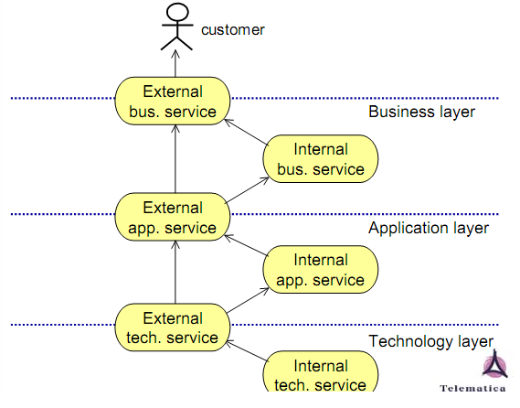
Layers

Slide 16
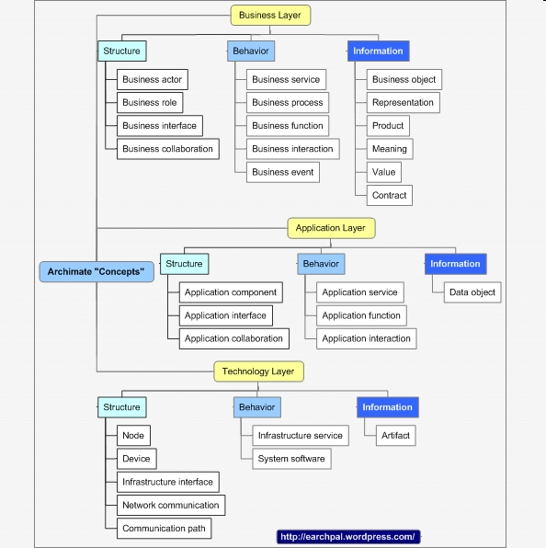
Layers , domains

Slide 17
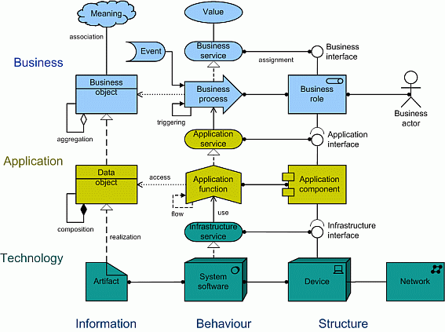
Layers , domains

Slide 18
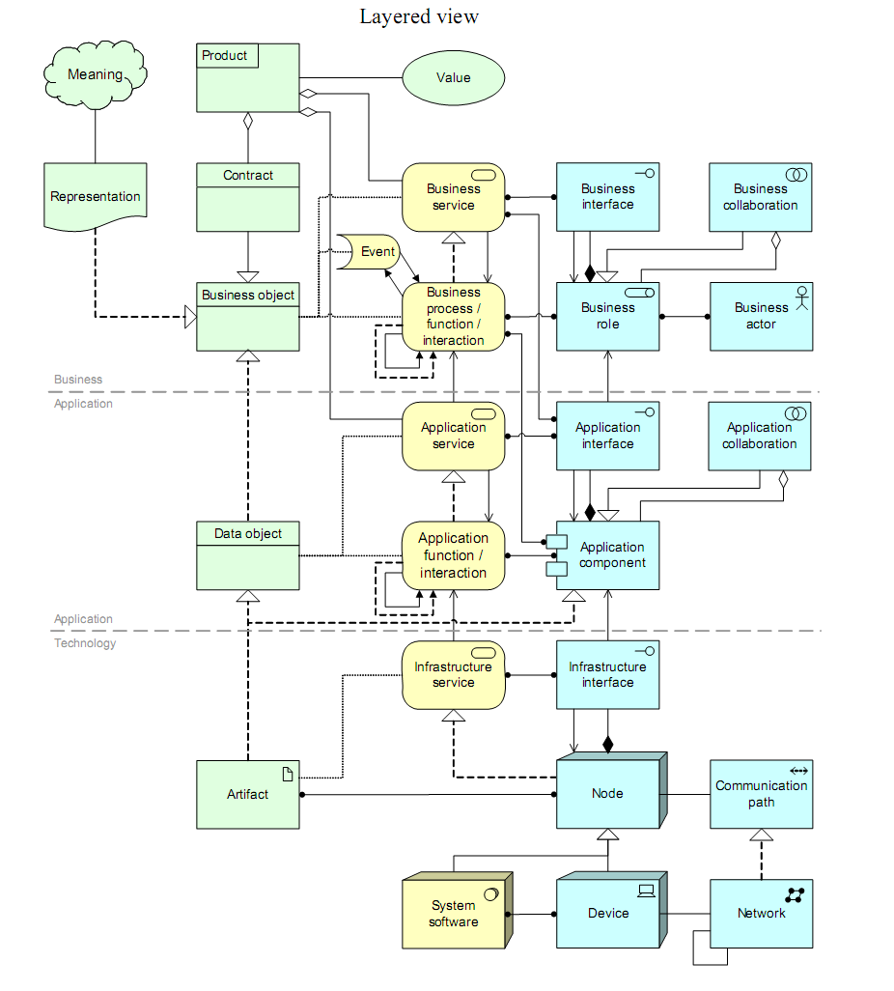
Overview of the ArchiMate concepts and main relationships.

Slide 19
ArchiMate vs UML
ArchiMate
ArchiMate was created to model the architecture of an enterprise (all of the systems in an organization).
ArchiMate models the business, information system (application and data), and technology architectures of the environment, including how these architectures are inter-related.
UML
UML still functions best as a way to document the architecture of a single system
UML provides 13 diagram types, providing flexibility to describe many different types of systems.

Slide 20
ArchiMate vs UML
Archimate started with an understanding that these problems relate to one another; that the entire complex and difficult business of understanding IT requires a rich inter-relationship of completely different domains, from business motivation to business process to managed services to systems to infrastructure.
Thus Archimate goes where UML doesn’t: it defines a metamodel that allows these relationships to be constructed, and constrained, and communicated. The constraints allow analysis, traceability, governance, and consistency. UML is unconstrained between model types. Archimate is not.

Slide 21
Notations
Every concept and relation should have a precise graphical notation, with a sufficient resemblance the ‘standard’ ArchiMate notation. The notation in the Visio stencils can be used as a guideline
Optionally, multiple notations may exist for a single concept.
It should be possible to denote composition, aggregation and assignment both with their ‘line’ notation and with nesting.

Slide 22
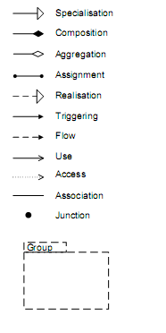
Relations
The following relation types should be supported:
  Structural relations:
    composition*
    aggregation
    assignment
    used by
    realisation
    access
    association
  Dynamic relations:
    triggering
    flow
  Other relations:
    grouping
    junction
    specialisation*

Slide 23
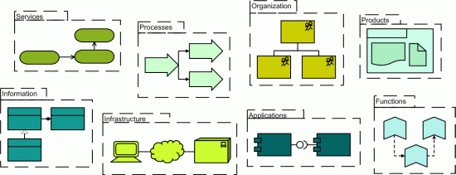
Notations

Slide 24
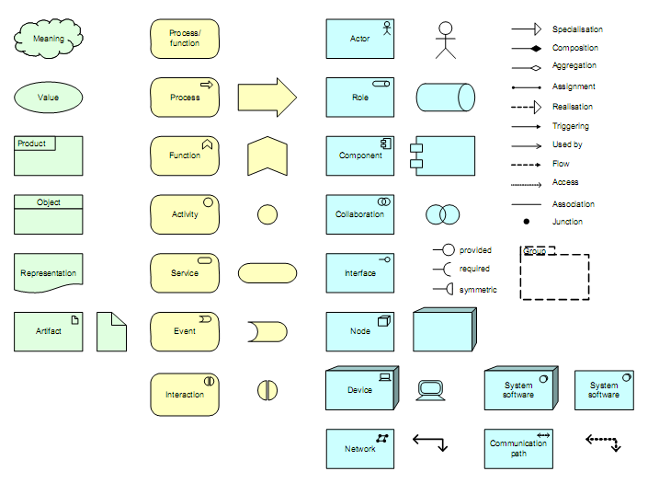
Notations & Relations

Slide 25
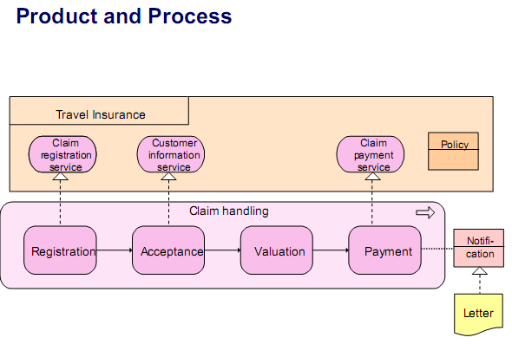
Demo

Slide 26
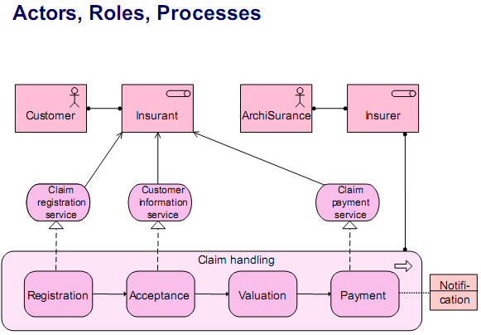
Demo

Slide 27
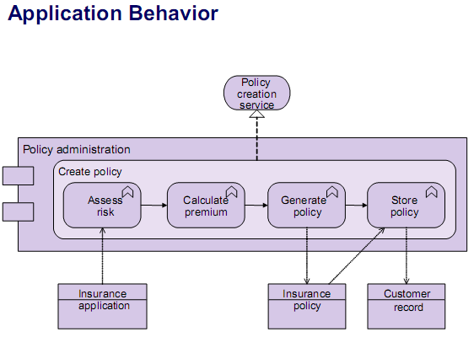
Demo

Slide 28
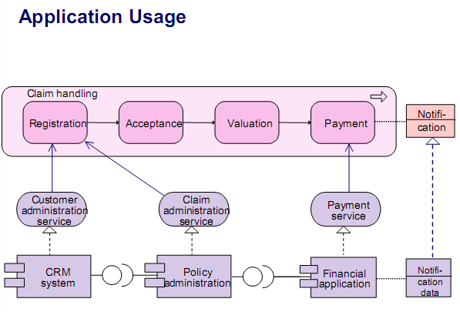
Demo

Slide 29
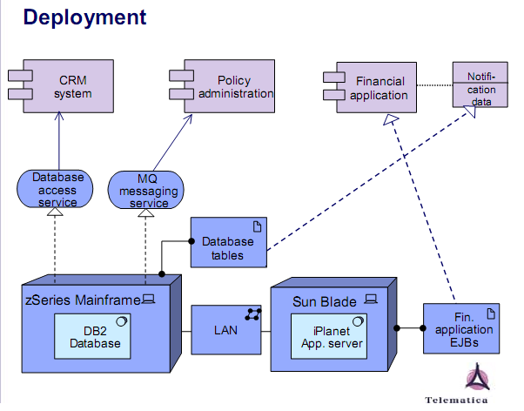
Demo

Slide 30
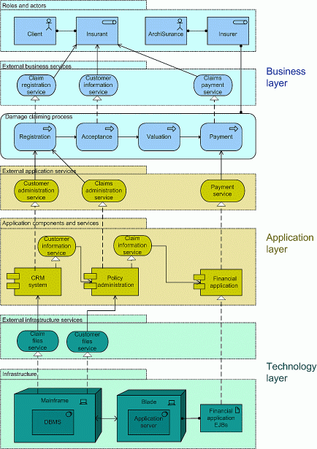

Slide 31
